Slide 1

Emerging Technologies
Session #10: An introduction to IBM Cloudant
IBM Bluemix
The Digital Innovation Platform
Sylvain-Roch WILBERT
s_wilbert@fr.ibm.com
Université Paris - Dauphine

Slide 2
IBM Cloudant in a nutshell
In RDBMS(Relational Database Management System),
a single entity is stored in a row , containing a series of columns
These entities are defined in a schema, so that every row will have the same columns.
In NoSQL (NOSQL or ‘Not-only’ SQL)
No definition of a schema
Every entities is stored as a document with any number of fields, under a JSON format uniquely identified by an id and a revision id
Querying
Querying is analogous to SELECT in SQL. You can not only query across fields in collections of documents. Index can be setup to fine tuned the performance accesses

Slide 3

IBM Cloudant in a nutshell
Cloudant
Is a NoSQL database
Is hosted and managed database-as-a-service (DBaaS)
Provides an HTTP API to the JSON data
GET: Request the specified item.
POST: Upload data. Within Cloudant’s API, POST is used to set values, including uploading documents, setting document values, and starting certain administration commands.
PUT: Used to put a specified resource. In Cloudant’s API, PUT is used to create new objects, including databases, documents, views and design documents.
DELETE: Deletes the specified resource, including documents, views, and design documents.
COPY: A special method that can be used to copy documents and objects.

Slide 4
JSON
JSON: JavaScript Object Notation.
JSON is a syntax for storing and exchanging data.
JSON is text based on { } hierarchy and a pair “attribut:value”
{ "name": "Bobby", "age":12, "city": »Paris" }

Slide 5
Exercize– IBM Cloudant
Directory : 06-cloudantenabled
Objective is to persist the data in a NoSQL repository (replacing the volatile in-memory session)
STEP01 : Deploy a new node js Application in Bluemix.
STEP02 : Add a NoSQL repository service to this application (IBM Cloudant)
STEP03 : Configure the Cloudant repository (new database, Index)
STEP04 : Retrieve the credential to access the Cloudant repository
STEP05 : Local development relying on the Cloudant database
STEP06 : Once finished, deploy the app in blumix using GIT
Remark : Step 01 is made only to ease the demo by avoiding to resolve potential conflicts students may have on an existing application relying on GIT

Slide 6
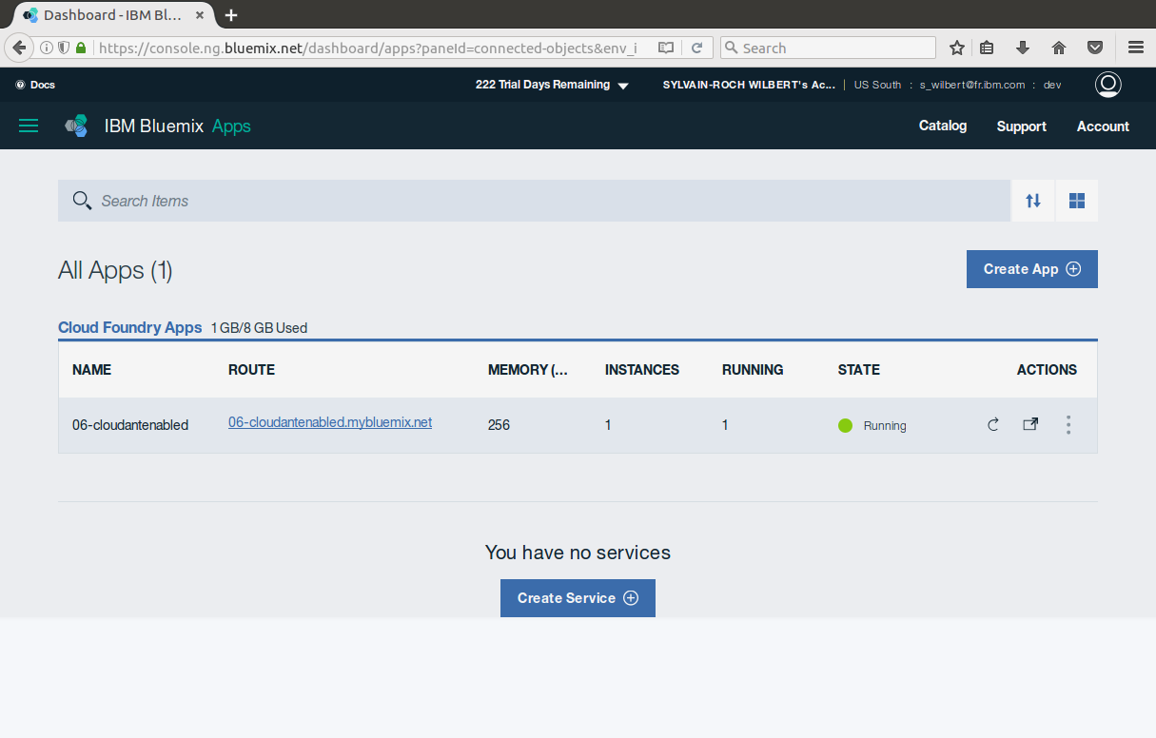
Exercize – My Application Setting up the IBM Cloudant repository

Slide 7
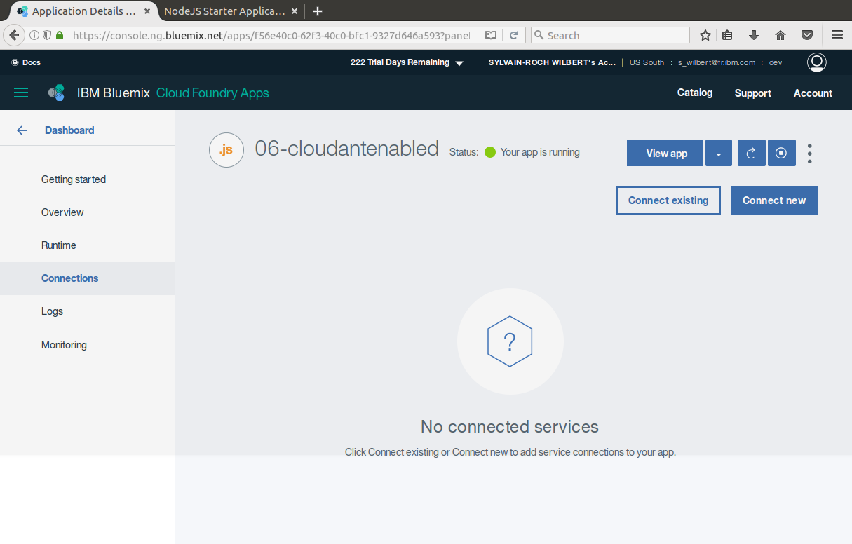
2
1

Slide 8
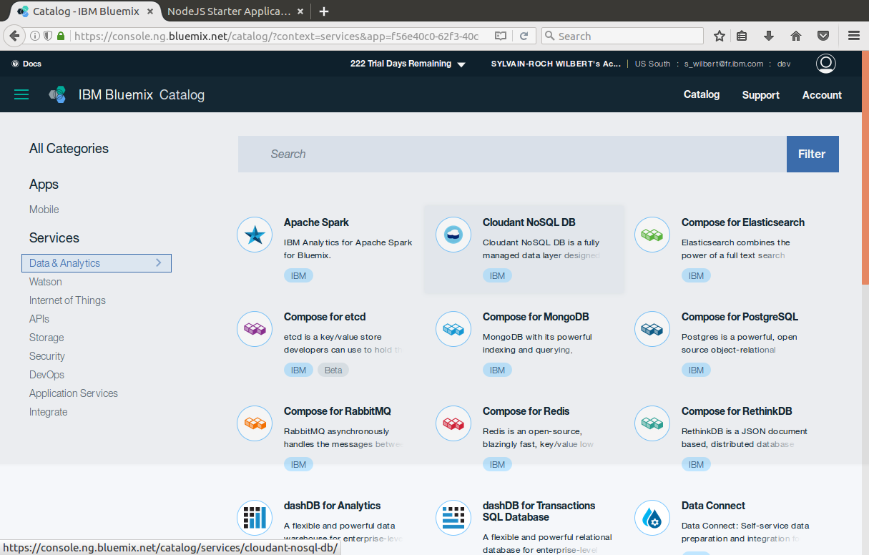
2
1

Slide 9
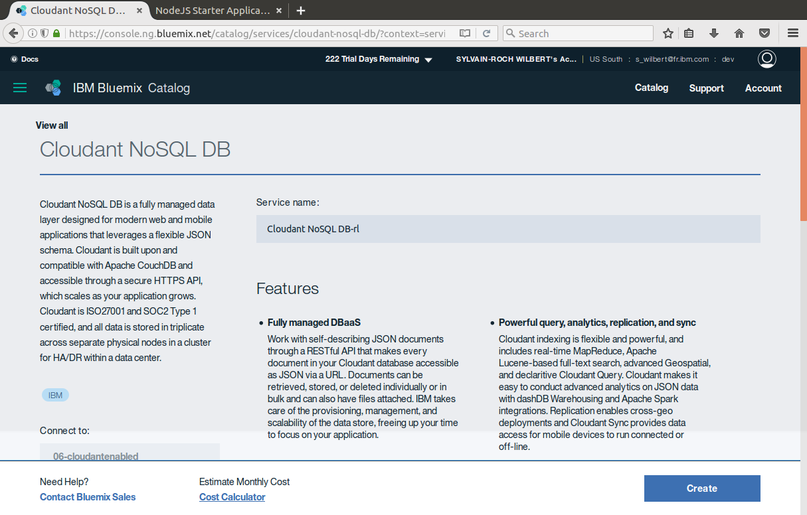

Slide 10
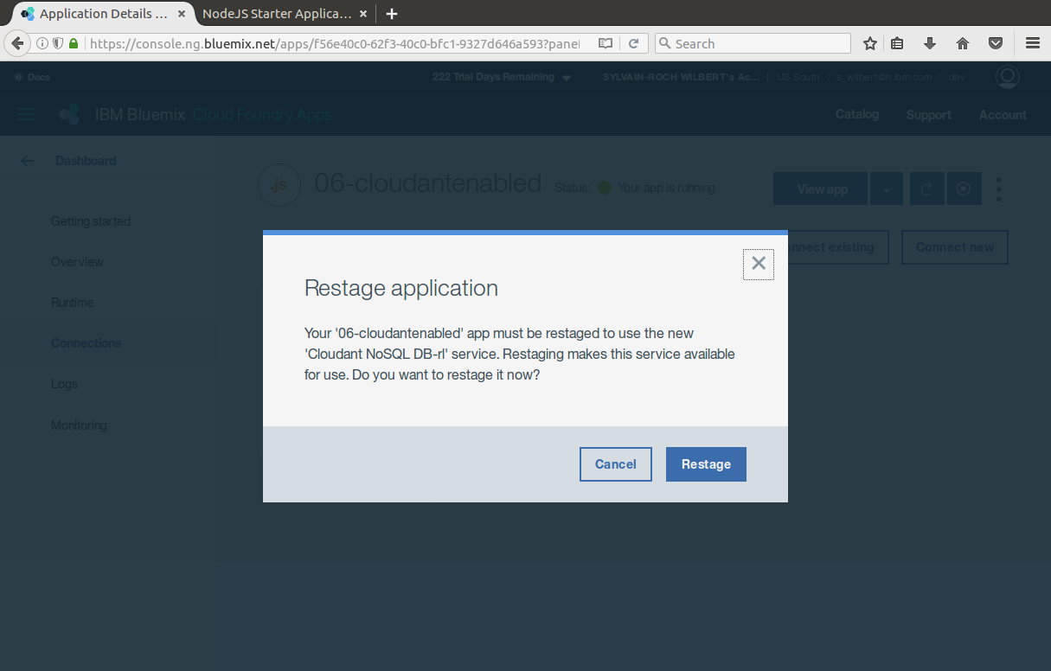

Slide 11
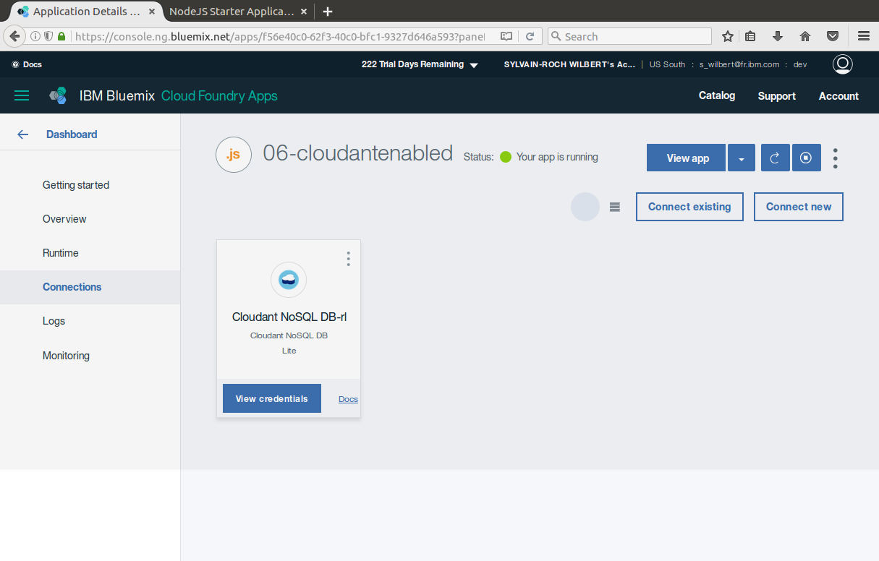

Slide 12
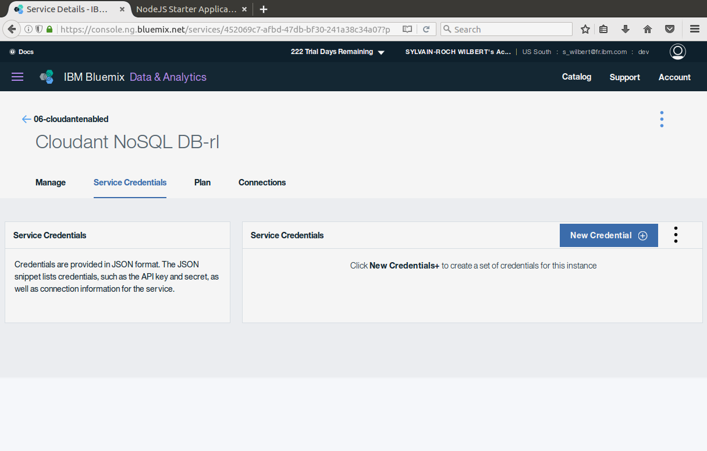
1
2

Slide 13
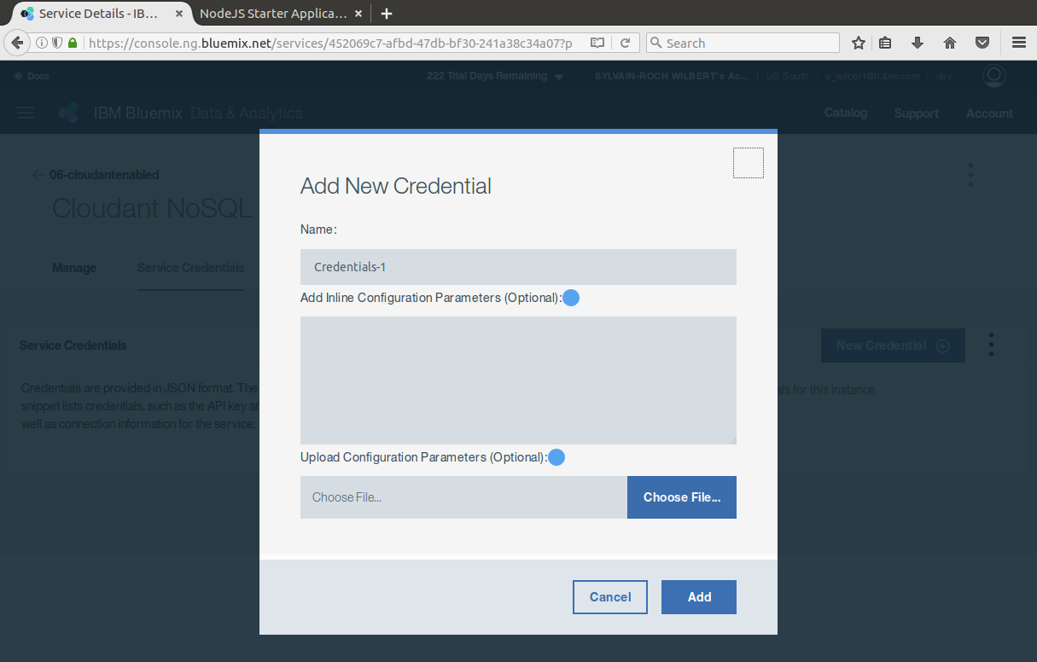

Slide 14
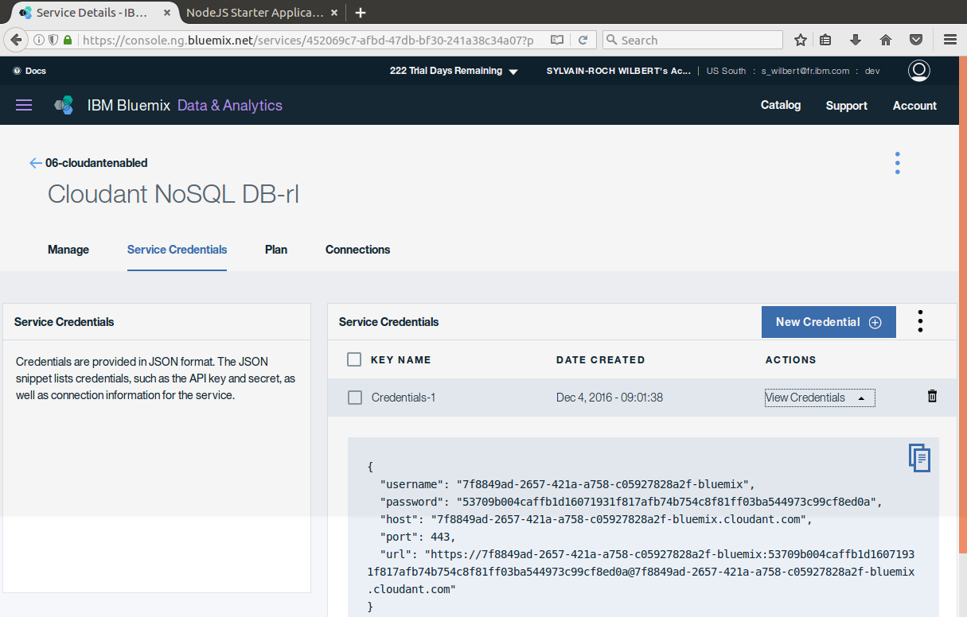
1

Slide 15
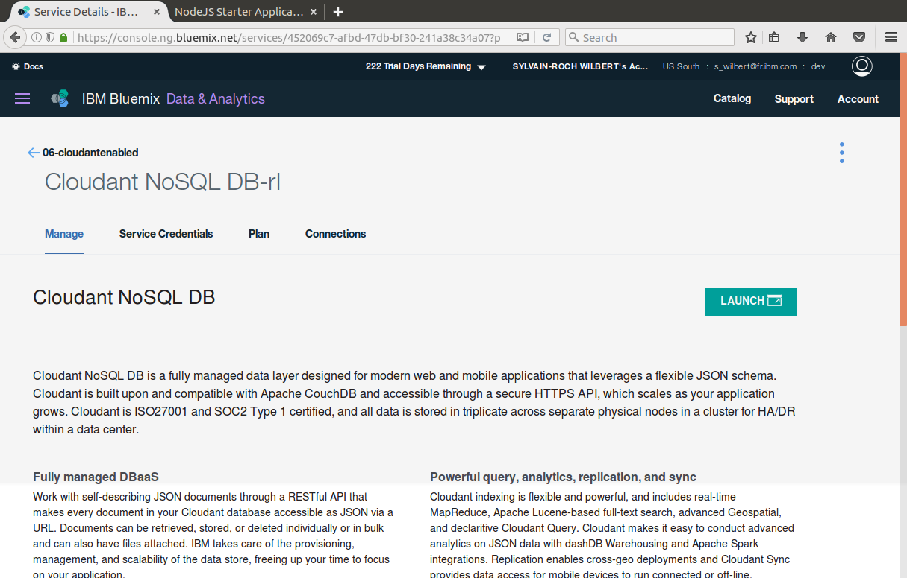
1
2

Slide 16
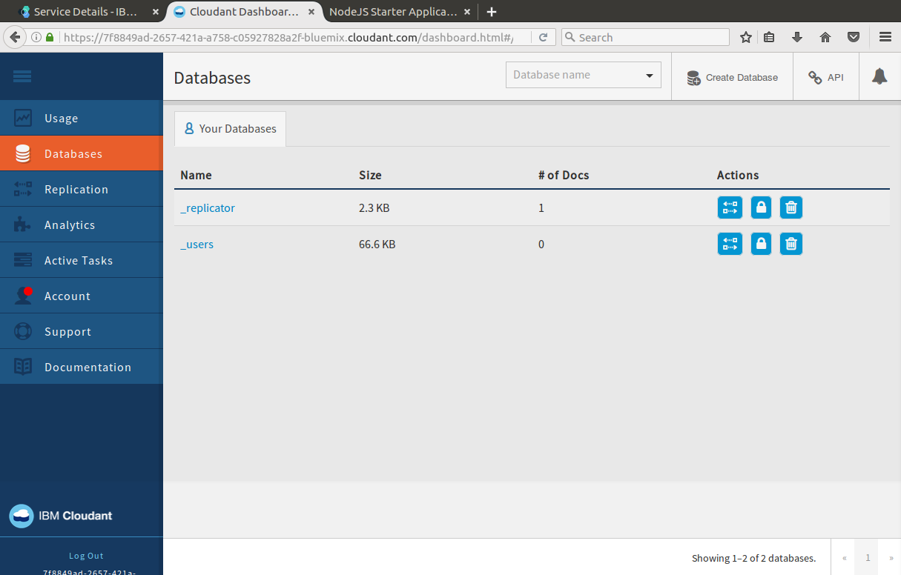
2
1

Slide 17
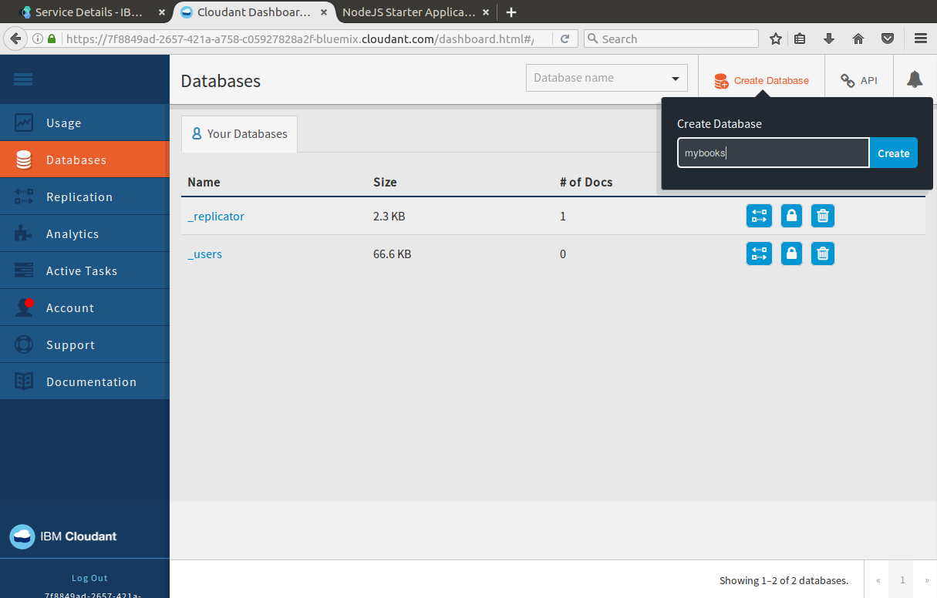

Slide 18
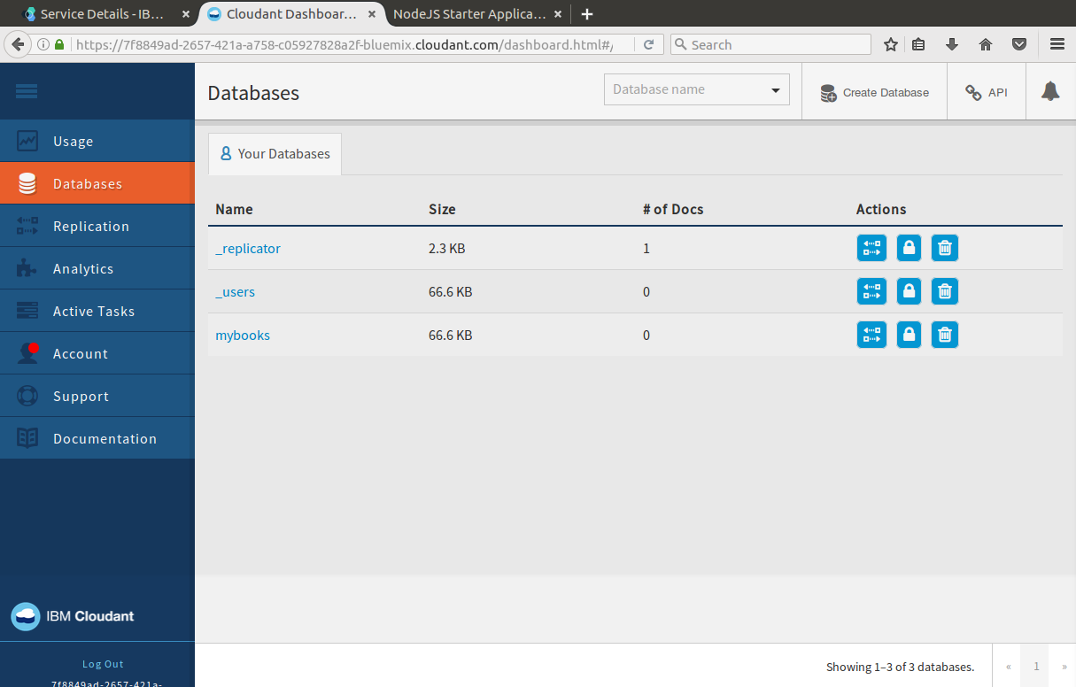
1
2

Slide 19
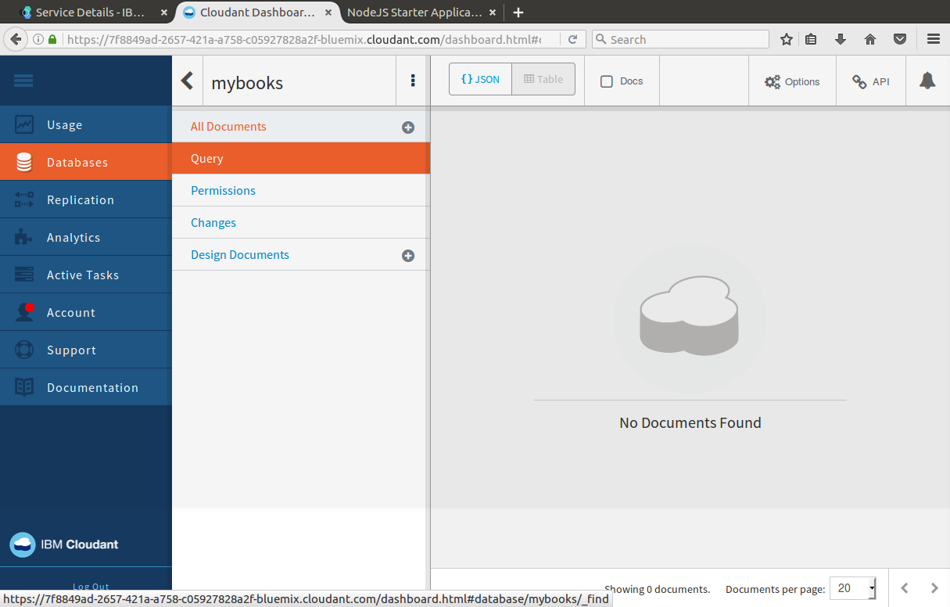
1

Slide 20
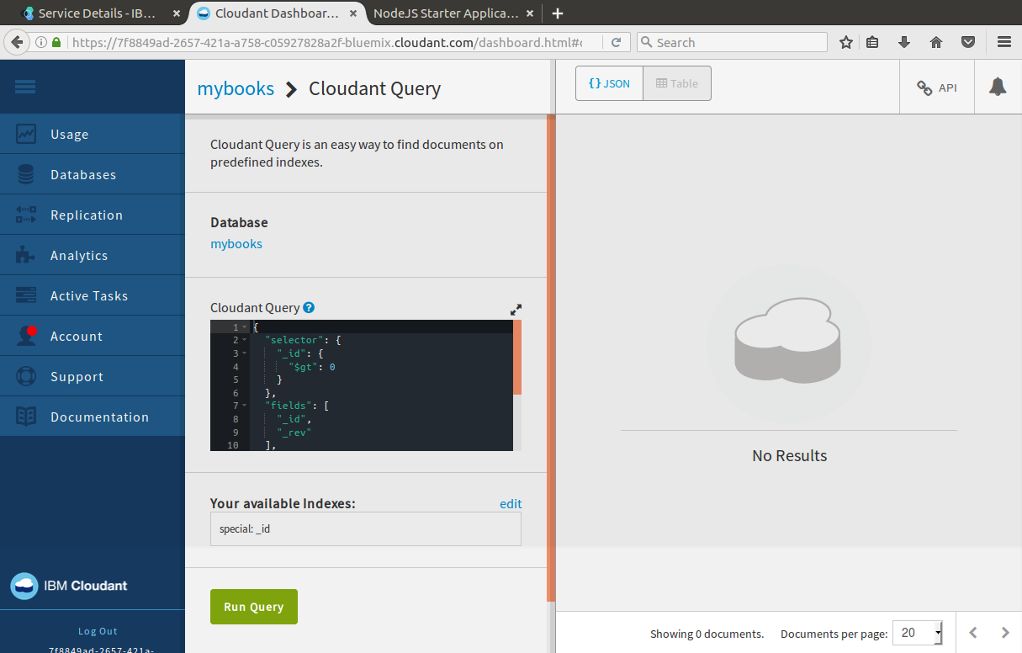
1

Slide 21
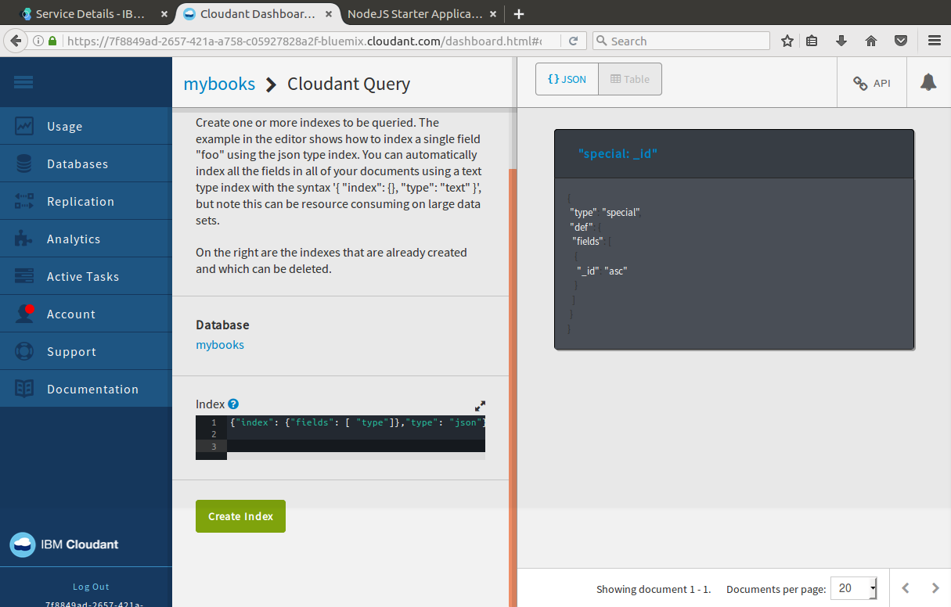
Add a new index on a “type” field, that will be used to categorize the object ‘Book”
{"index": {"fields": [ "type"]},"type": "json"}
1

Slide 22
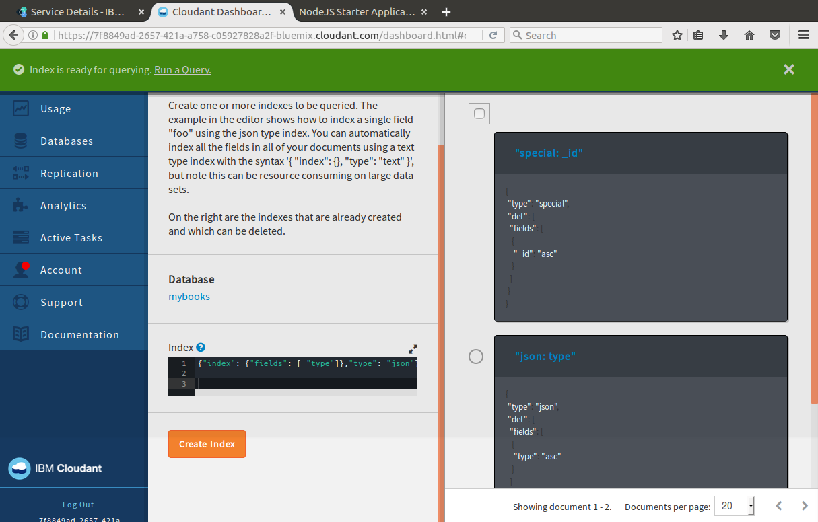
1

Slide 23
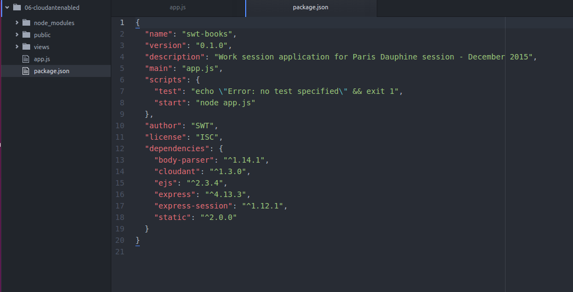
Exercize – My Application Adjusting the app
Directory : 06-cloudantenabled
Objective is to persist the data in a NoSQL repository (replacing the volatile in-memory session)
package.json
The cloudant is required (see previous exercises)

Slide 24
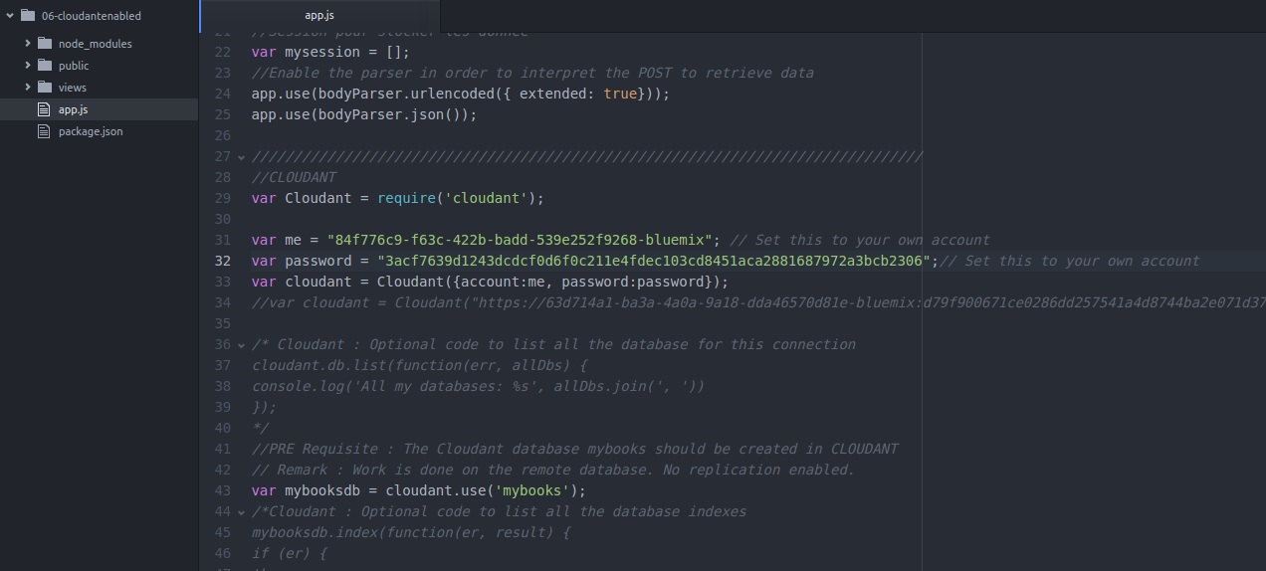
Exercize– My Application Adjusting the app
app.js
1
2
Insert here you personal IBM Cloudant Credentials
3

Slide 25
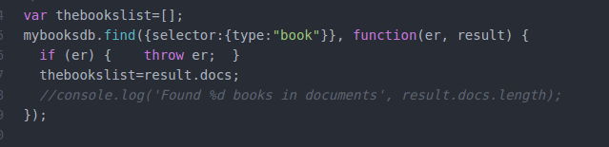
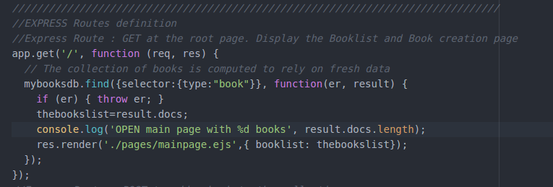
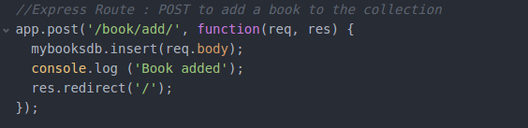
Exercize– My Application Adjusting the app
The list of books is initialized by parsing the index of type=«book» object
Routes are updated
Default
Add a book: Insert request

Slide 26
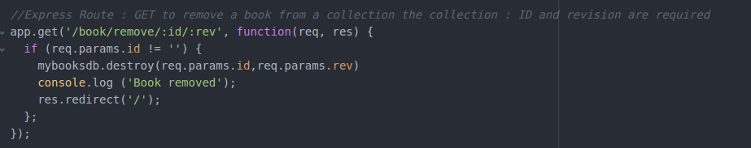
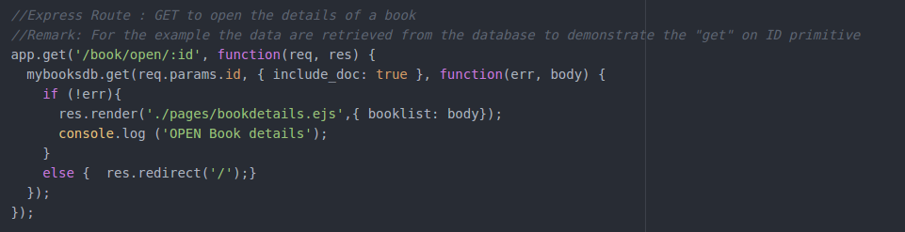
Exercize– My Application Adjusting the app
Routes are updated
Remove a book (ID and revision is required)
Open Details: ID is used

Slide 27
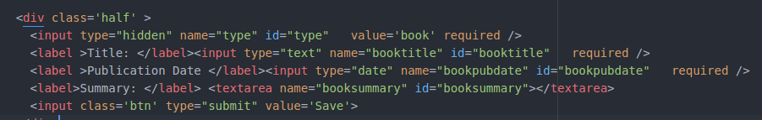
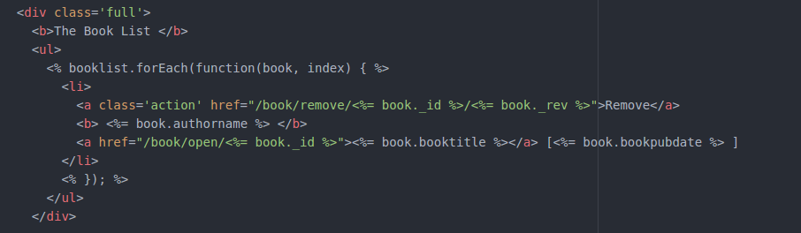
Exercize– My Application Adjusting the app
Adjust the templates
main page
- Insert a type hidden field in order to categorize the objects in Cloudant
- the booklist is adjusted
to open the page details with the id
to remove a book with the id and revision

Slide 28
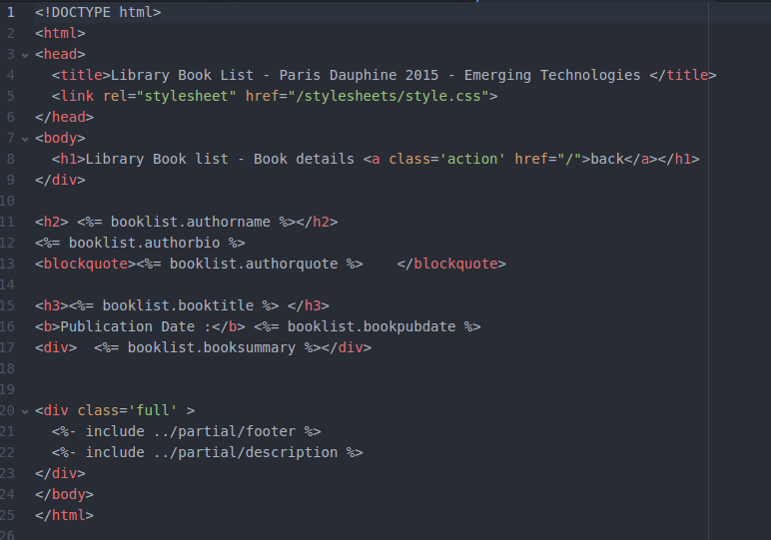
Exercize– My Application Adjusting the app
Adjust the templates
details page

Slide 29
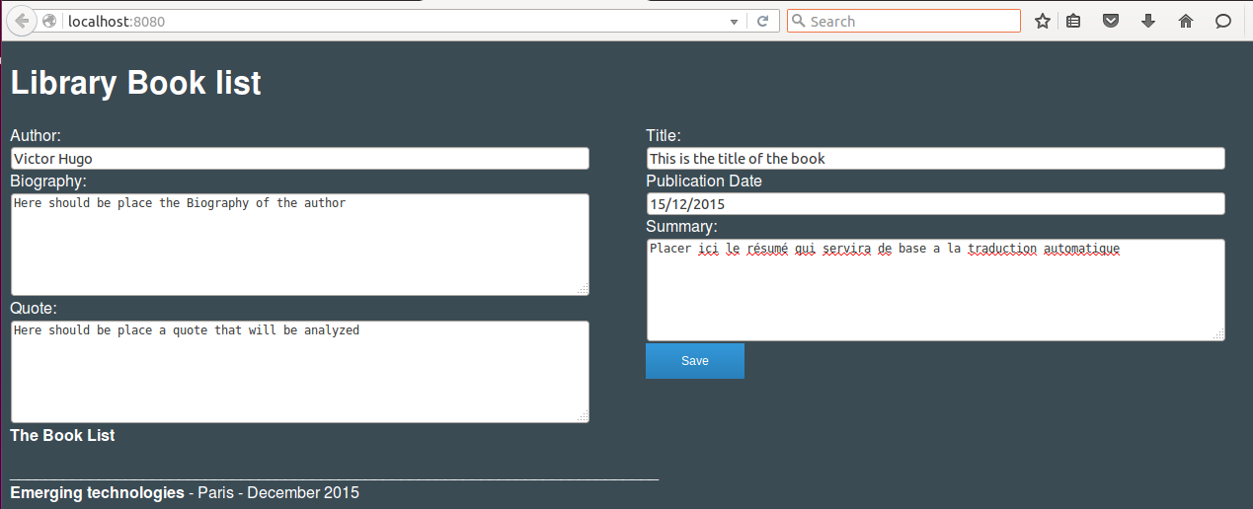
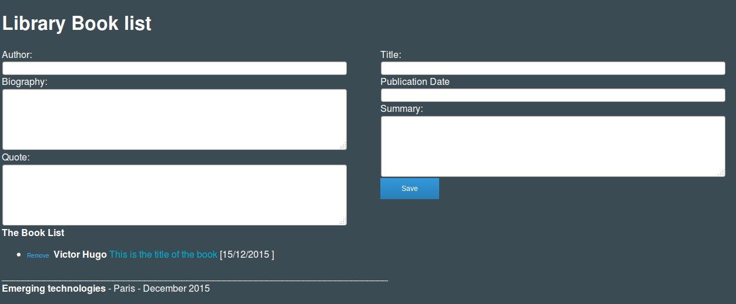
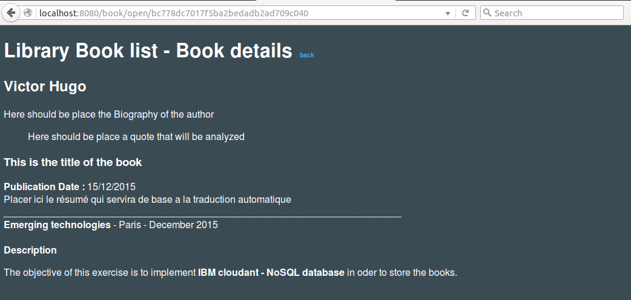
Exercize– My Application Use you app and verify the data in Cloudant

Slide 30
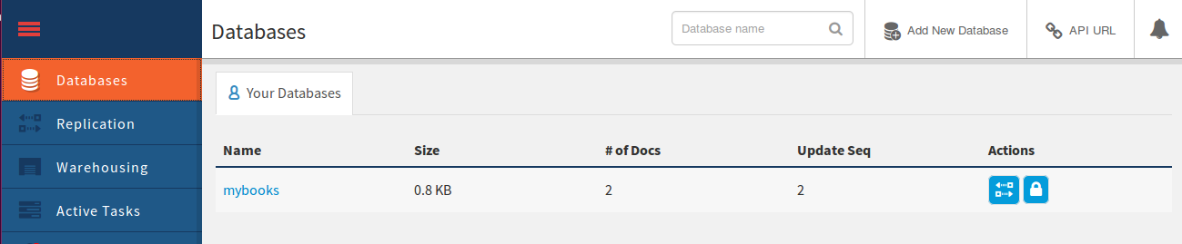
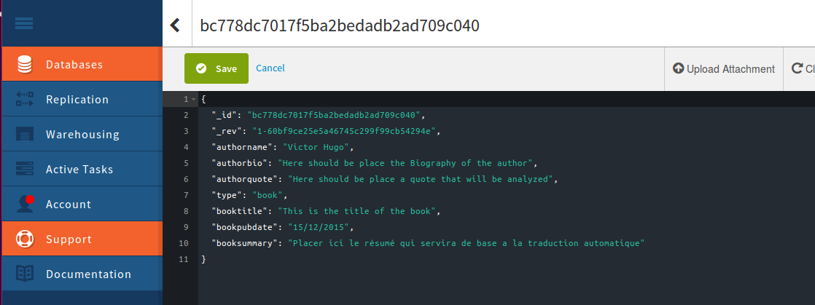
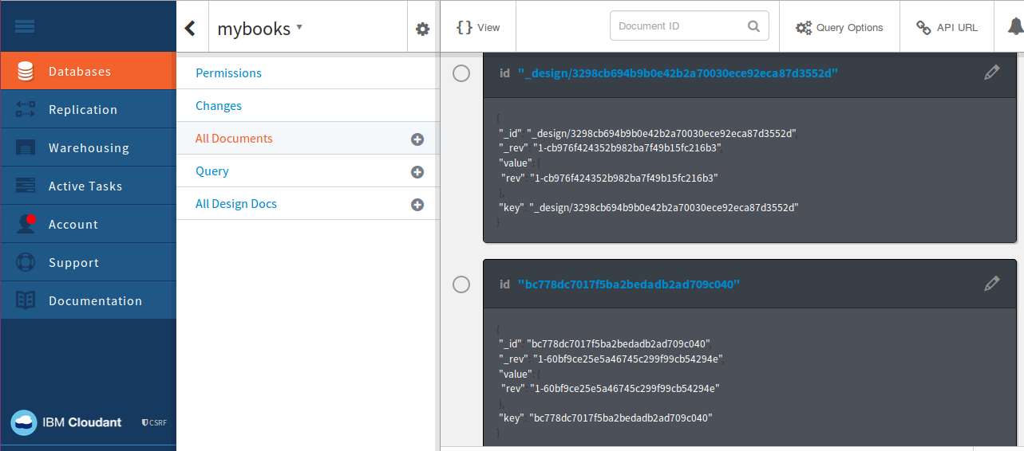
Exercize– My Application Use you app and verify the data in Cloudant

Slide 31
Exercize– My Application Redeploy on the correct application using GIT
Application shall be redeployed on you Bluemix space using the GIT repository.
(see previous exercizes)

